Slide 1
COMP 2710 Software Construction
Overloading
Dr. Xiao Qin
Auburn University
http://www.eng.auburn.edu/~xqin
xqin@auburn.edu
Fall
, 2012
These slides are adapted from notes by Dr. Walter Savitch (UCSD)
Notes:
Objectives:
I/O Streams
File I/O
Character I/O
Tools for Stream I/O
File names as input
Formatting output, flag settings
Stream Hierarchies
Preview of inheritance
Random Access to Files

Slide 2
Overloading
Same function name
Different parameter lists
Two separate function definitions
Function "signature"
  Function name & parameter list
  Must be "unique" for each function definition
Allows same task performed on different data
Copyright © 2008 Pearson Addison-Wesley. All rights reserved.
4-<number>

Slide 3
Overloading Example: Average
Function computes average of 2 numbers:
double average(double n1, double n2)
{
return ((n1 + n2) / 2.0);
}
Now compute average of 3 numbers:
double average(double n1, double n2, double n3)
{
return ((n1 + n2 + n3) / 3.0);
}
Same name, two functions
Copyright © 2008 Pearson Addison-Wesley. All rights reserved.
4-<number>

Slide 4
Overloaded Average() Cont’d
Which function gets called?
Depends on function call itself:
  avg = average(5.2, 6.7);
    Calls "two-parameter average()"
  avg = average(6.5, 8.5, 4.2);
    Calls "three-parameter average()"
Compiler resolves invocation based on
signature of function call
  "Matches" call with appropriate function
  Each considered separate function
Copyright © 2008 Pearson Addison-Wesley. All rights reserved.
4-<number>

Slide 5
Overloading Pitfall
Only overload "same-task" functions
  A mpg() function should always perform
  same task, in all overloads
  Otherwise, unpredictable results
C++ function call resolution:
  1st: looks for exact signature
  2nd: looks for "compatible" signature
Copyright © 2008 Pearson Addison-Wesley. All rights reserved.
4-<number>

Slide 6
Overloading Resolution
1st: Exact Match
  Looks for exact signature
    Where no argument conversion required
2nd: Compatible Match
  Looks for "compatible" signature where
  automatic type conversion is possible:
    1st with promotion (e.g., int→double)
      No loss of data
    2nd with demotion (e.g., double→int)
      Possible loss of data
Copyright © 2008 Pearson Addison-Wesley. All rights reserved.
4-<number>

Slide 7
Overloading Resolution Example
Given following functions:
  1. void f(int n, double m);
  2. void f(double n, int m);
  3. void f(int n, int m);
  These calls:
  f(98, 99); → ?
  f(5.3, 4); → ?
  f(4.3, 5.2); → ?
Avoid such confusing overloading
Calls #3
Calls #2
Calls ???
Copyright © 2008 Pearson Addison-Wesley. All rights reserved.
4-<number>

Slide 8
Automatic Type Conversion and Overloading
Numeric formal parameters typically
made "double" type
Allows for "any" numeric type
  Any "subordinate" data automatically promoted
    int → double
    float → double
    char → double *More on this later!
Avoids overloading for different numeric types
Copyright © 2008 Pearson Addison-Wesley. All rights reserved.
4-<number>

Slide 9
COMP 2710 Software Construction
File I/O
Dr. Xiao Qin
Auburn University
http://www.eng.auburn.edu/~xqin
xqin@auburn.edu
Spring, 2012
These slides are adapted from notes by Dr. Walter Savitch (UCSD)
Notes:
Objectives:
I/O Streams
File I/O
Character I/O
Tools for Stream I/O
File names as input
Formatting output, flag settings
Stream Hierarchies
Preview of inheritance
Random Access to Files

Slide 10
Introduction
Streams
  Special objects
  Deliver program input and output
File I/O
  Uses inheritance
    Not covered until chapter 14
  File I/O very useful, so covered here
Copyright © 2008 Pearson Addison-Wesley. All rights reserved.
12-<number>

Slide 11
Streams
A flow of characters
Input stream
  Flow into program
    Can come from keyboard
    Can come from file
Output stream
  Flow out of program
    Can go to screen
    Can go to file
Copyright © 2008 Pearson Addison-Wesley. All rights reserved.
12-<number>

Slide 12

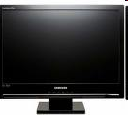
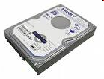
Streams Usage
We’ve used streams already
  cin
    Input stream object connected to keyboard
  cout
    Output stream object connected to screen
Can define other streams
  To or from files
  Used similarly as cin, cout
12-<number>

Slide 13
Streams Usage Like cin, cout
Consider:
  Given program defines stream inStream
  that comes from some file:
  int theNumber;
  inStream >> theNumber;
    Reads value from stream, assigned to theNumber
  Program defines stream outStream that goes
  to some file
  outStream << "theNumber is " << theNumber;
    Writes value to stream, which goes to file
Copyright © 2008 Pearson Addison-Wesley. All rights reserved.
12-<number>

Slide 14
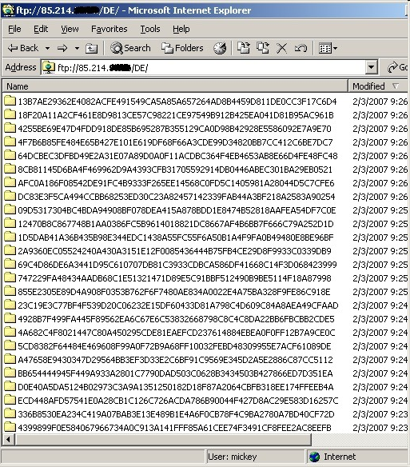
Files
We’ll use text files
Reading from file
  When program takes input
Writing to file
  When program sends output
Start at beginning of file to end
  Other methods available
  We’ll discuss this simple text file access here
Copyright © 2008 Pearson Addison-Wesley. All rights reserved.
12-<number>

Slide 15
File Connection
Must first connect file to stream object
For input:
  File → ifstream object
For output:
  File → ofstream object
Classes ifstream and ofstream
  Defined in library <fstream>
  Named in std namespace
Copyright © 2008 Pearson Addison-Wesley. All rights reserved.
12-<number>

Slide 16
File I/O Libraries
To allow both file input and output in your
program:
#include <fstream>
using namespace std;
OR
#include <fstream>
using std::ifstream;
using std::ofstream;
Why should we include “fstream”?
Copyright © 2008 Pearson Addison-Wesley. All rights reserved.
12-<number>
Notes:
Why should we include “fstream”?

Slide 17
Declaring Streams
Stream must be declared like any other
class variable:
ifstream inStream;
ofstream outStream;
Must then "connect" to file:
inStream.open("infile.txt");
  Called "opening the file"
  Uses member function open
  Can specify complete pathname
Copyright © 2008 Pearson Addison-Wesley. All rights reserved.
12-<number>
Notes:
Declare; Open; and Use.

Slide 18
Streams Usage
Once declared → use normally!
int oneNumber, anotherNumber;
inStream >> oneNumber >> anotherNumber;
Output stream similar:
ofstream outStream;
outStream.open("outfile.txt");
outStream << "oneNumber = " << oneNumber
<< " anotherNumber = "
<< anotherNumber;
  Sends items to output file
Copyright © 2008 Pearson Addison-Wesley. All rights reserved.
12-<number>

Slide 19
File Names
Programs and files
Files have two names to our programs
  External file name
    Also called "physical file name"
    Like "infile.txt"
    Sometimes considered "real file name"
    Used only once in program (to open)
  Stream name
    Also called "logical file name"
    Program uses this name for all file activity
Copyright © 2008 Pearson Addison-Wesley. All rights reserved.
12-<number>

Slide 20
Closing Files
Files should be closed
  When program completed getting input or
  sending output
  Disconnects stream from file
  In action:
  inStream.close();
  outStream.close();
    Note no arguments
Files automatically close when program ends
Copyright © 2008 Pearson Addison-Wesley. All rights reserved.
12-<number>

Slide 21
File Flush
Output often "buffered"
  Temporarily stored before written to file
  Written in "groups"
Occasionally might need to force writing:
outStream.flush();
  Member function flush, for all output streams
  All buffered output is physically written
Closing file automatically calls flush()
Copyright © 2008 Pearson Addison-Wesley. All rights reserved.
12-<number>

Slide 22
File Flush
Output often "buffered"
  Temporarily stored before written to file
  Written in "groups"
Occasionally might need to force writing:
outStream.flush();
  Member function flush, for all output streams
  All buffered output is physically written
Closing file automatically calls flush()
Copyright © 2008 Pearson Addison-Wesley. All rights reserved.
12-<number>

Slide 23
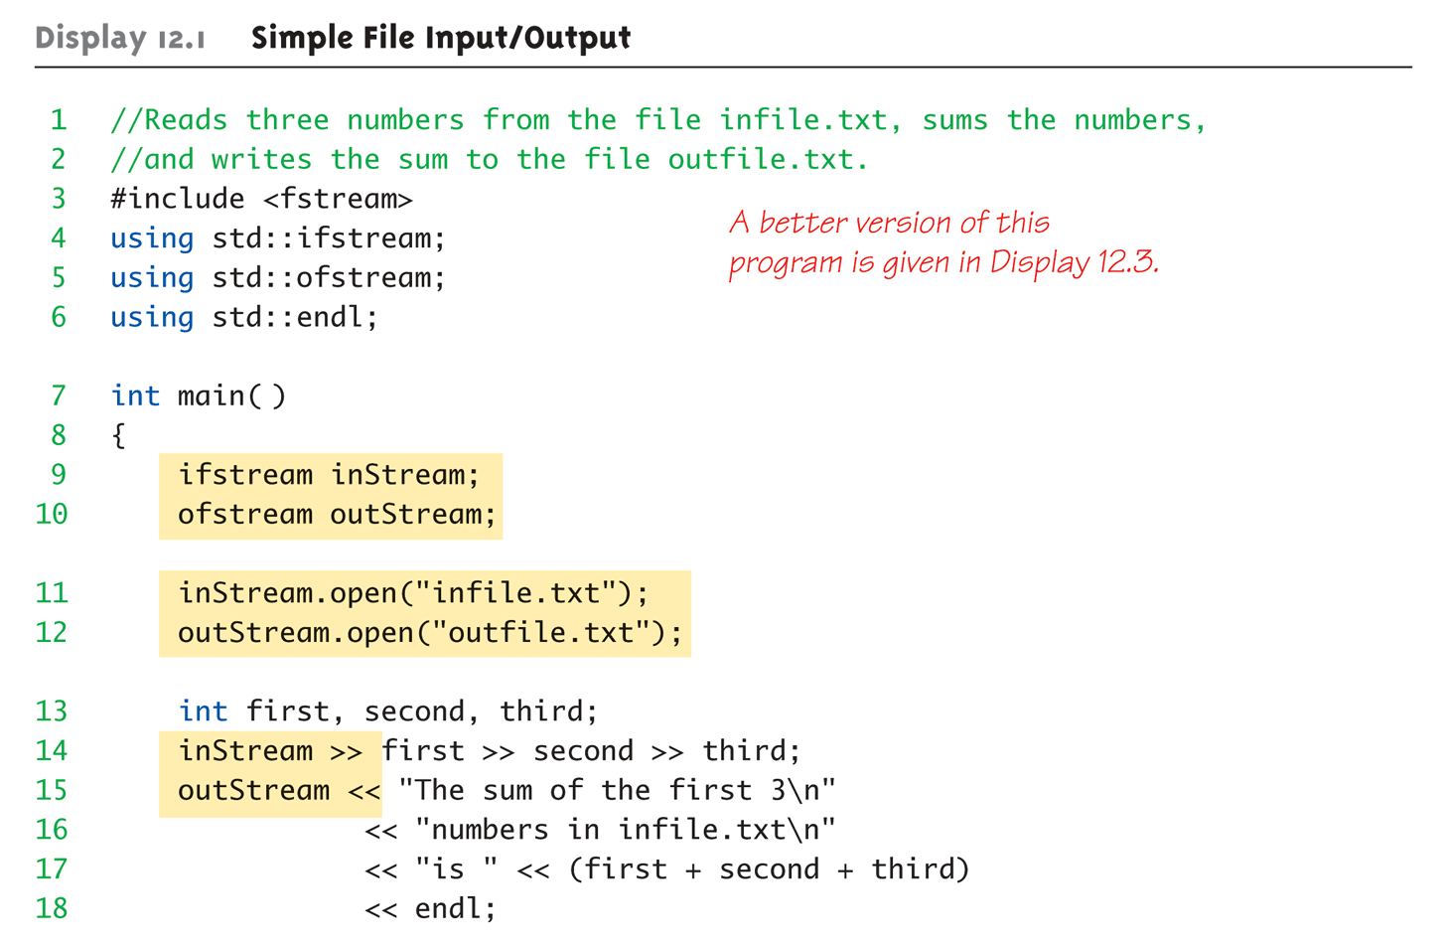
File Example:
Display 12.1 Simple File
Input/Output (1 of 2)
Copyright © 2008 Pearson Addison-Wesley. All rights reserved.
12-<number>

Slide 24
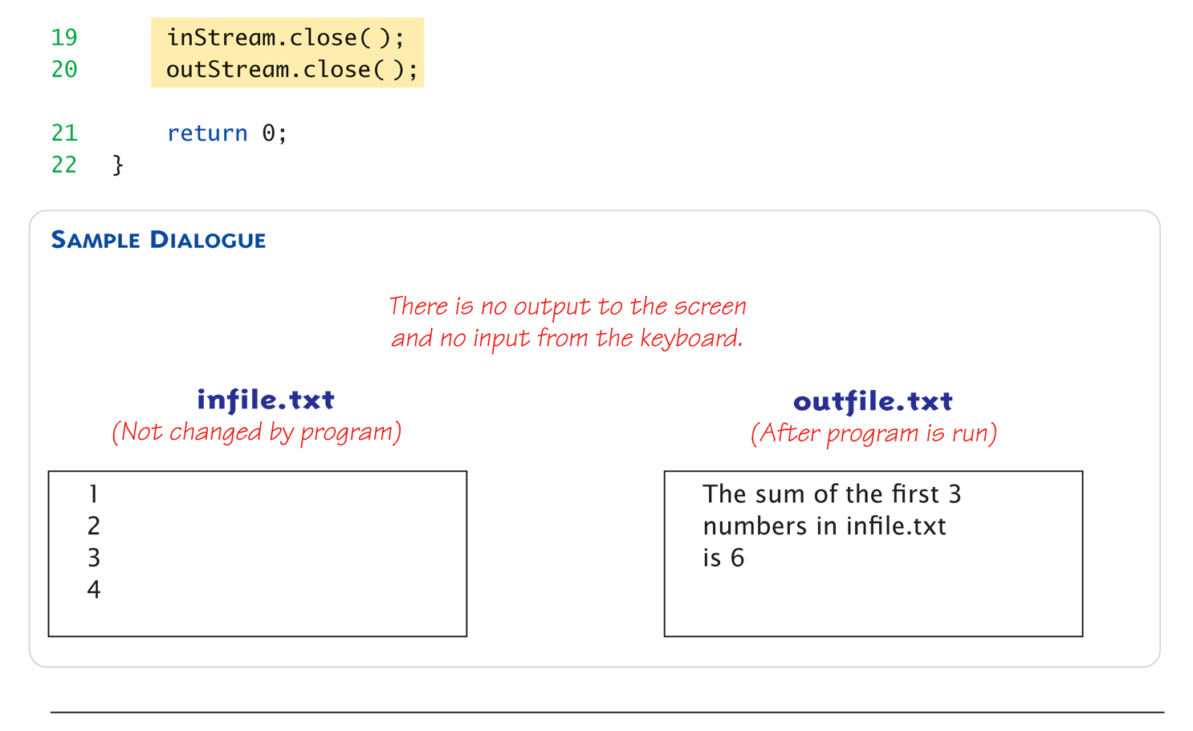
File Example:
Display 12.1 Simple File
Input/Output (1 of 2)
Copyright © 2008 Pearson Addison-Wesley. All rights reserved.
12-<number>

Slide 25
Exercise
Declare and open input file stream fileIn and output file stream fileOut. Attach these to files named input.dat and output.dat. Write #include directives for any required header files. Make certain names from namespaces are accessible.
Copyright © 2008 Pearson Addison-Wesley. All rights reserved.
12-<number>

Slide 26
Answer
#include <fstream>
. . .
ifstream fileIn;
ofsream fileOut;
fileIn.open(“input.dat”);
fileOut.open(“output.dat”);
Copyright © 2008 Pearson Addison-Wesley. All rights reserved.
12-<number>

Slide 27
Appending to a File
Standard open operation begins with
empty file
  Even if file exists → contents lost
Open for append:
ofstream outStream;
outStream.open("important.txt", ios::app);
  If file doesn’t exist → creates it
  If file exists → appends to end
  2nd argument is class ios defined constant
    In <iostream> library, std namespace
Copyright © 2008 Pearson Addison-Wesley. All rights reserved.
12-<number>

Slide 28
Alternative Syntax for File Opens
Can specify filename at declaration
  Passed as argument to constructor
ifstream inStream;
inStream.open("infile.txt");
EQUIVALENT TO:
ifstream inStream("infile.txt");
Copyright © 2008 Pearson Addison-Wesley. All rights reserved.
12-<number>

Slide 29
Character I/O with Files
All cin and cout character I/O same
for files!
Member functions work same:
  get, getline
  put, putback,
  peek, ignore
Copyright © 2008 Pearson Addison-Wesley. All rights reserved.
12-<number>

Slide 30
End of File Check with Read
Second method
  read operation returns bool value!
  (inStream >> next)
    Expression returns true if read successful
    Returns false if attempt to read beyond end of file
  In action:
  double next, sum = 0;
  while (inStream >> next)
  sum = sum + next;
  cout << "the sum is " << sum << endl;
Copyright © 2008 Pearson Addison-Wesley. All rights reserved.
12-<number>

Slide 31
Summary
Streams connect to files with open operation
Stream member functions format output
  e.g., width, setf, precision
  Same usage for cout (screen) or files
Copyright © 2008 Pearson Addison-Wesley. All rights reserved.
12-<number>

